Slide 1
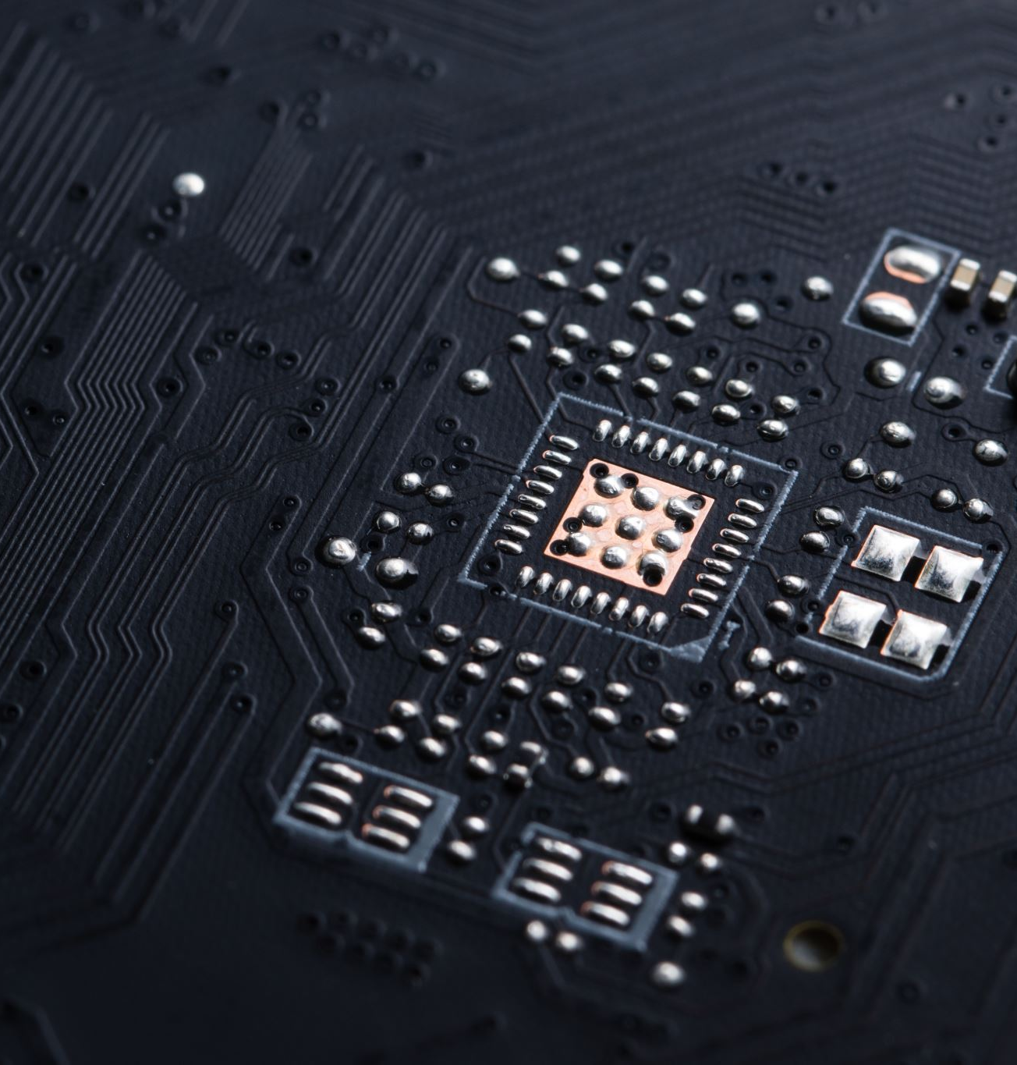
Arduino MCU basics
What is an MCU
Arduino MCU’s

Slide 2
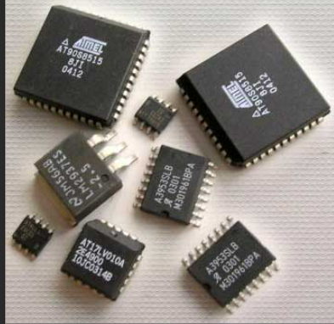
What is an MCU??
Acronym for: Micro controller unit.
IC ( integregrated circuit, Processer unit)
Communications interfaces (example: USB -serial)
Memory modules
Peripherals (I/O pins)

Slide 3

Various MCU’s
Many manufactures.
Proprietary or open-source.
Sizes and complexity

Slide 4
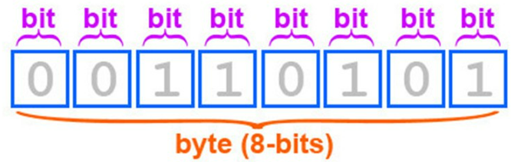
Processor - digital logic
Mikro processor: thousands of transistors making decisions based on ‘0’s and ‘1’s
Our program gets compiled into machine laungage (‘0’s and ‘1’s) which the processor understands.
One transistor represents 1 bit.

Slide 5
Peripherals – GPIO pins
Interacting with the ‘real’ world.
Read Inputs: sensors, buttons, switches etc…
Write Outputs: motors, lights, valves etc…

Slide 6

Digital & analog
Digital: True or false, ‘1’ or ‘0’, HIGH or LOW... 2 states
MCU’s and most other computing devices only understand binary
That’s why they rely on specific circuit hardware in order to interface with the analog world.
Analog-to-digital converters (ADCs) sample an analog voltage and output a number representing the voltage relative to the measurement range - such as 0 to 1023 on a 10-bit ADC
Digital-to-analog converters (DACs) do the reverse, where a digital number from the microcontroller is used to output an analog voltage, e.g. between ground and the supply voltage.
Arduino’s analogWrite function (PWM) is 8 bit.
what is the value scale?

Slide 7
2 arduino MCU’s
Arduino UNO (R3)
Arduino mkr1010
AVR,
ATMEGA328P chip
USB-B
14 DIO pins, 6 AI pins
UART, I2C, SPI
2KB SRAM, 32KB FLASH, 1KB EEPROM
ARM Cortex M0+, ATSAMD21G18 chip
USB-B (micro)
8 DIO pins(4 PWM), 7 AI pins, 1 AO pin
UART, I2C, SPI
448 KB ROM, 520KB SRAM, 2MB Flash
Notes:
MKR WiFi 1010 | Arduino Documentation
UNO R3 | Arduino Documentation

Slide 8
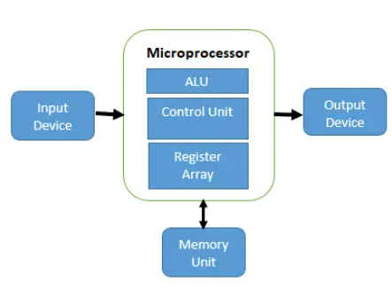
MCU how it functions
Program loaded in (via assembler using language such as C++ and burned into the chip via a programming tool)
Program is stored in its non-volatile (flash) memory and gets executed right away.
While running it uses its RAM memory for run-time variables in the program.
It will sense its inputs and drive its outputs according to the program.

